Slide 1
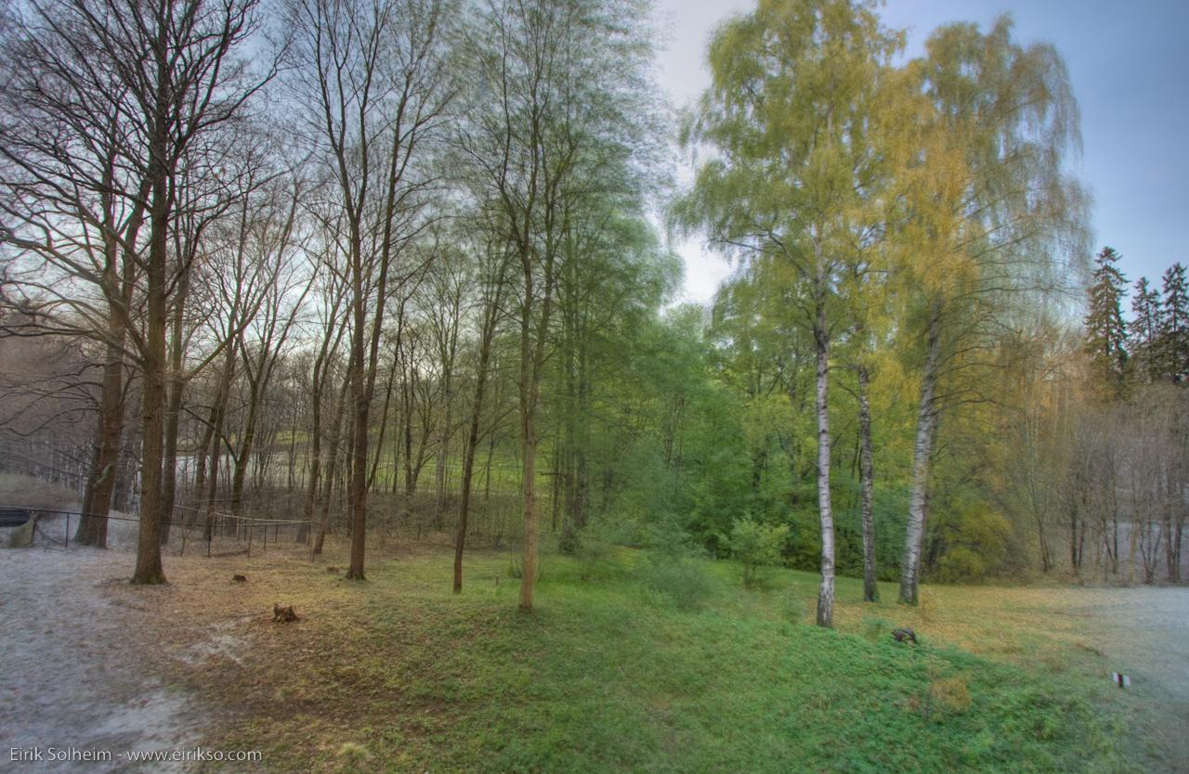
Tracking Winter in a Warming World
Elizabeth Burakowski, University of New Hampshire
Alix Contosta, Rebecca Sanders-DeMott, UNH
John L. Campbell, US Forest Service
NEEEA, Lake Morey VT November 3, 2018
Notes:
Period between snowmelt and full canopy leaf-out
Exposure of soils and streams to light: time of ecological opportunity

Slide 2
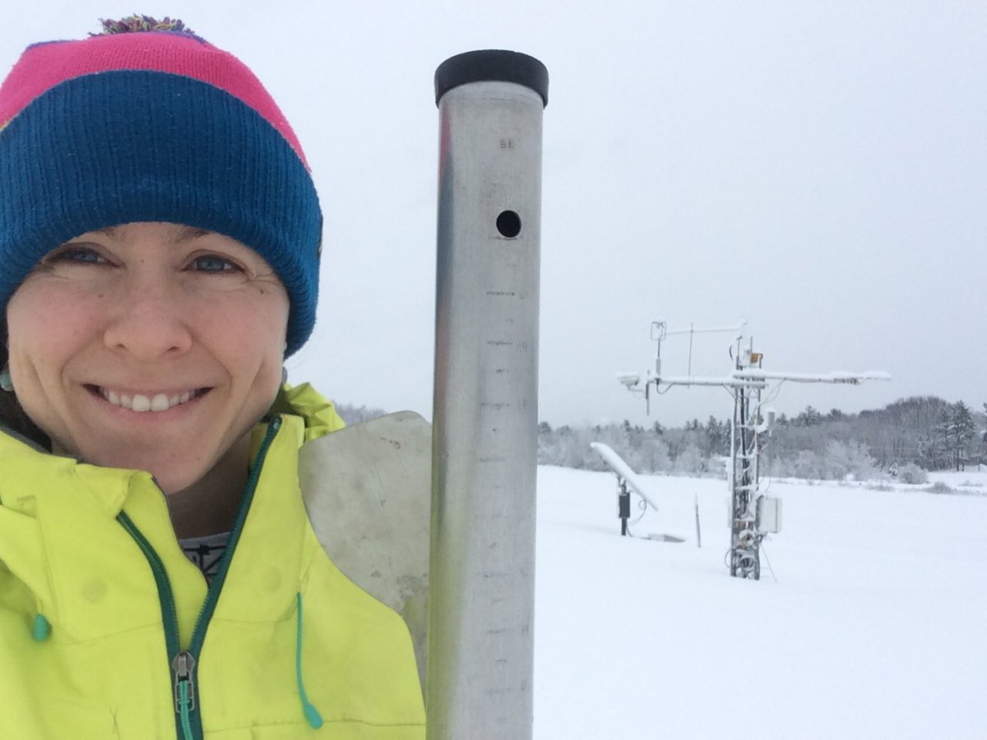

Kahiltna Glacier
Denali Nat’l Park

Slide 3
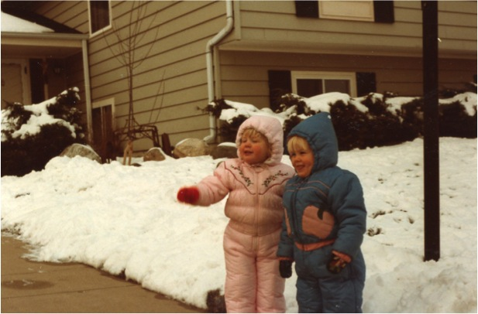
Prof. Burakowski and her twin sister
c. 1984
UNH Emeriti &
Retired Faculty Association
Durham, NH
March 21, 2018
Elizabeth Burakowski, UNH – ASIAQ-2 – October 2018 – Tokyo
Notes:
And so it begins. A lifelong obsession with snow. We moved to NH about 4 years later.

Slide 4
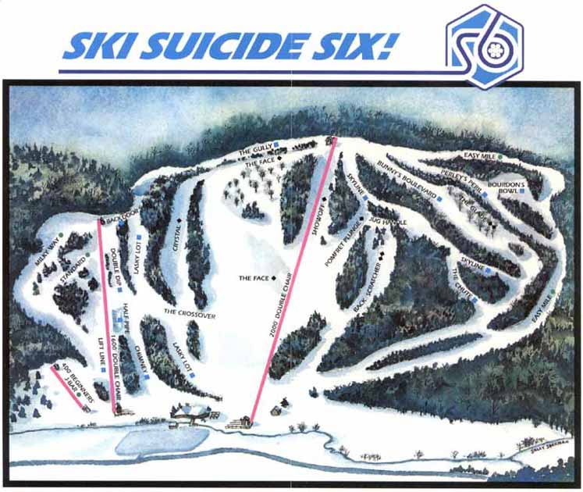
1988
South Pomfret, VT
Notes:
My first mountain.

Slide 5
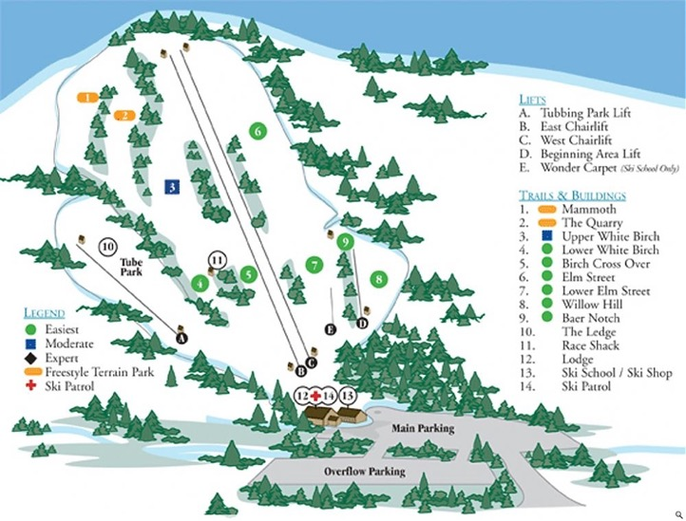
1989-1992
Manchester, NH
McIntyre
Notes:
My first ski club.

Slide 6
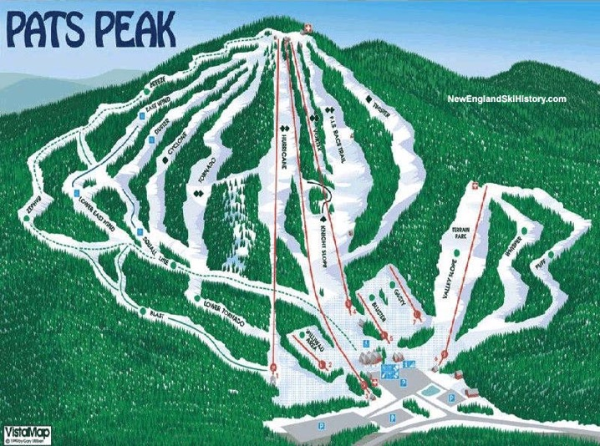
1993-1995
Henniker, NH
Notes:
My first time snowboarding. Haven’t looked back since. Though I did pick up splitboarding in 2013.

Slide 7
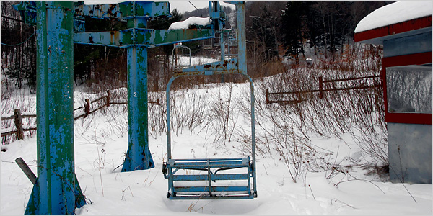
600+ ski areas closed
Photo: Paul O. Boisvert for The New York Times
New England Lost Ski Areas Project (nelsap.org)
Notes:
Some of this due to boom/bust. Some due to liability insurance. Some due to warm winters.
Maple Valley, pictured here, has been closed since 2000. Still for sale at $950,000.

Slide 8
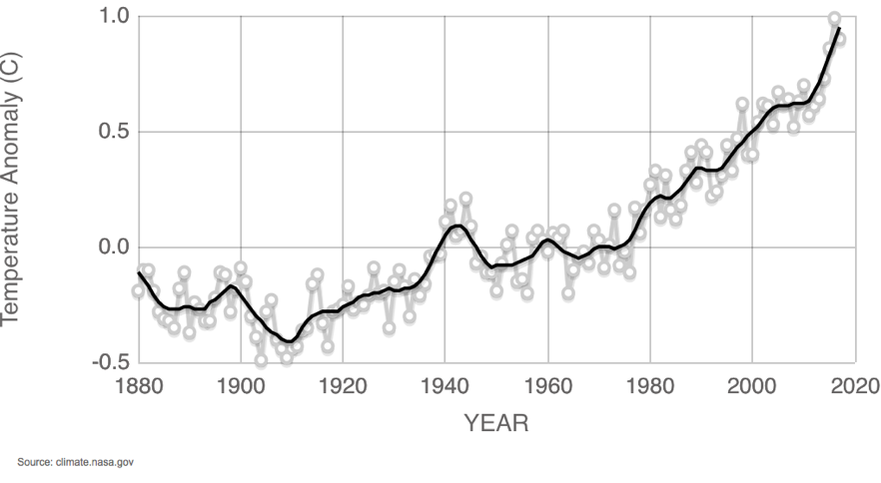
Global temperatures have been warmer than average since the late 1970s
Relative to the 1951-1980 average
Notes:
NASA ranked 2017 as second warmest on record (NOAA called it third warmest).
Seventeen of the last 18 years warmest years have occurred since 2001.
The coolest months of 2017 were warmer than the warmest months of the 1990s.

Slide 9
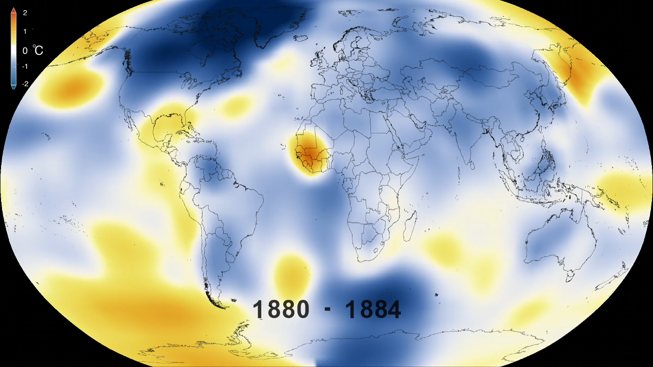
Temperature changes across the globe.
NASA Scientific Visualization Studio
Notes:
Video: https://svs.gsfc.nasa.gov/cgi-bin/details.cgi?aid=4419

Slide 10
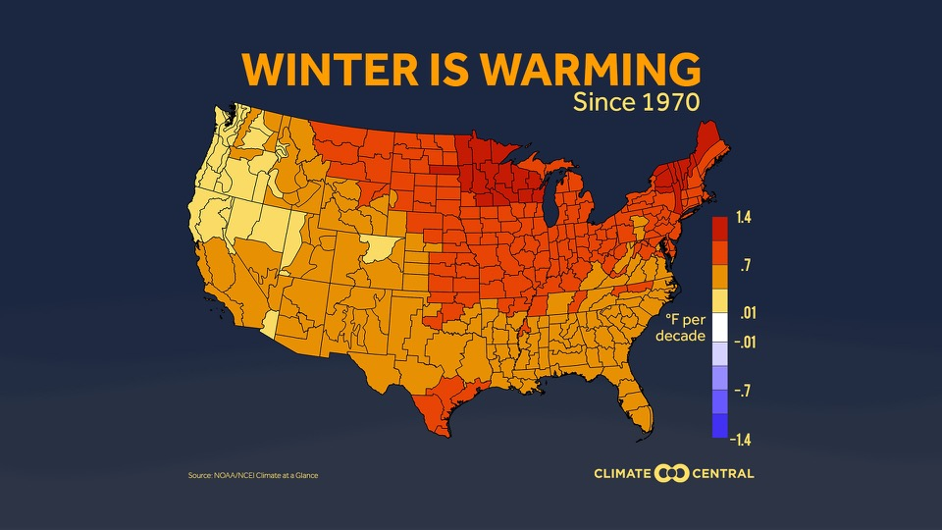
How has winter climate changed in the past?

Slide 11
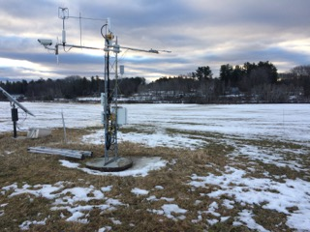
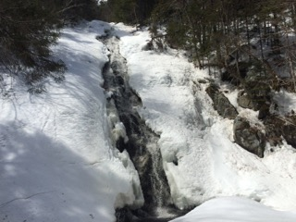

Other winter climate indicators
Fewer days with
snow cover
Earlier spring melt
Less snow, more rain.
Burakowski et al. 2008
Hodgkins et al. 2006
Huntington et al. 2004;
Brady & Sanford, 2016
Notes:
Brady & Sanford: http://assets.climatecentral.org/pdfs/Meltdown.pdf
- 80% of weather stations report more winter precip falling as rain, less as snow.

Slide 12
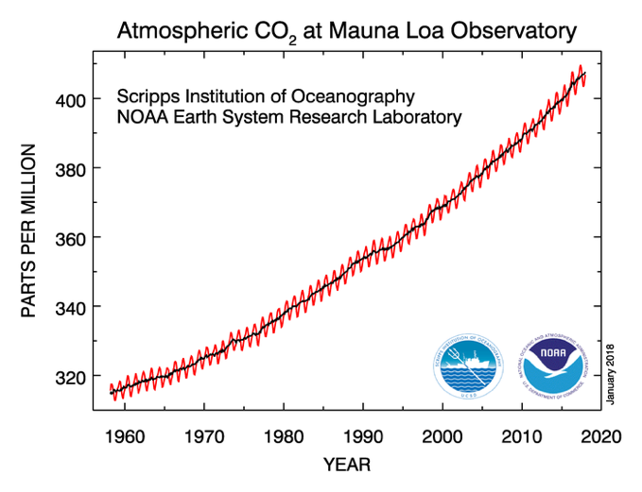




Carbon Dioxide (CO₂) levels increasing
410 ppm
360 ppm
380 ppm
351 ppm
Notes:
IPCC says changes in climate we’ve seen are extremely likely due to the accumulation of green house gasses in Earths’ atmosphere. The increase in GHGs is primarily from the burning of fossil fuels.
Big changes over just our own lifetimes. Grad school = 380 ppm.

Slide 13
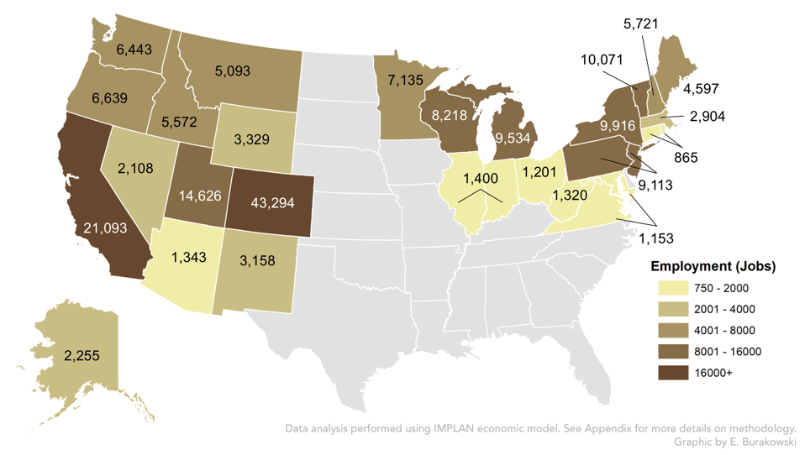
Jobs supported by the ski industry, 2015/16
Hagenstad, Burakowski, and Hill, 2018
Notes:
Vermont leads the NE in skier visits, followed by NY.
NY = 3.7M (2.6 in 15/16) skier visits
VT = 4.2M skier visits (long-term average; 3M in 15/16)..
This was a down year for the northeast.
9.4F above the long-term average,
above average precip but not enough snow.
Averaged across the state, only 33 days with snow depth > 4”.
2013/14 estimates around 7,000 or so.

Slide 14
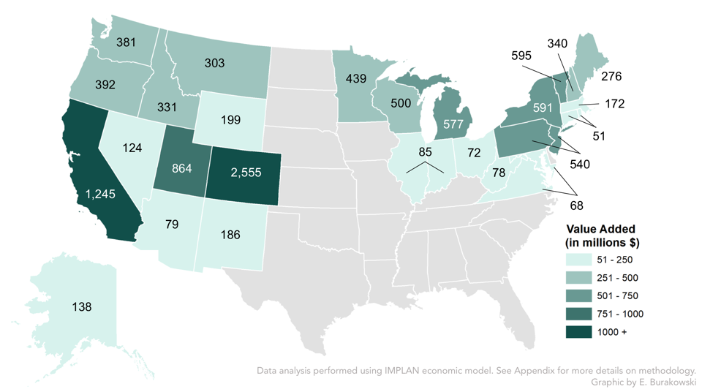
Ski Industry Economic Activity, 2015/16
Hagenstad, Burakowski, and Hill, 2018
Notes:
Note that this was a down year for the northeast. 2013/14 estimates around 7,000 or so.

Slide 15
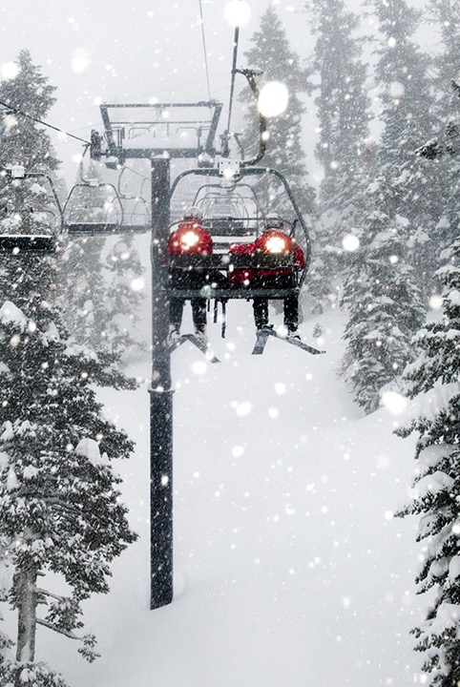
Relative to the 2001-2016 average
Top Five
↑ $692 Million
↑ 11,800 jobs
Notes:
Top five snowiest years compared to average vs. bottom five compared to average.
VT Bottom: 2016, 2012, 2006, 2010, 2013
VT Top: 2001, 2008, 2003, 2004, 2015.

Slide 16
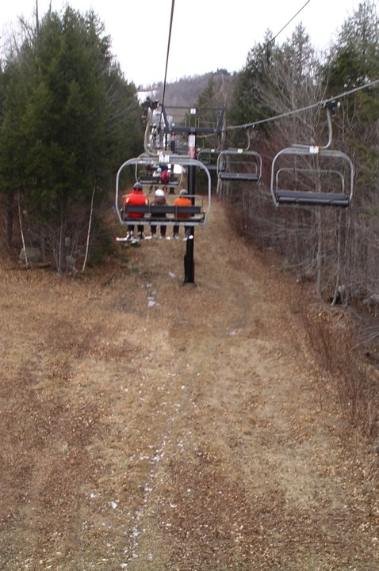
Relative to the 2001-2016 average
Top Five
↑ $692 Million
↑ 11,800 jobs
Bottom Five
↓ $1 Billion
↓ 17,400 jobs
Hagenstad, Burakowski, and Hill, 2018
Notes:
Keep in mind that this is during the modern era of snowmaking.
NH Bottom: 2016, 2012, 2006, 2007, 2002
NH Top: 2008, 2001, 2003, 2015, 2009.

Slide 17
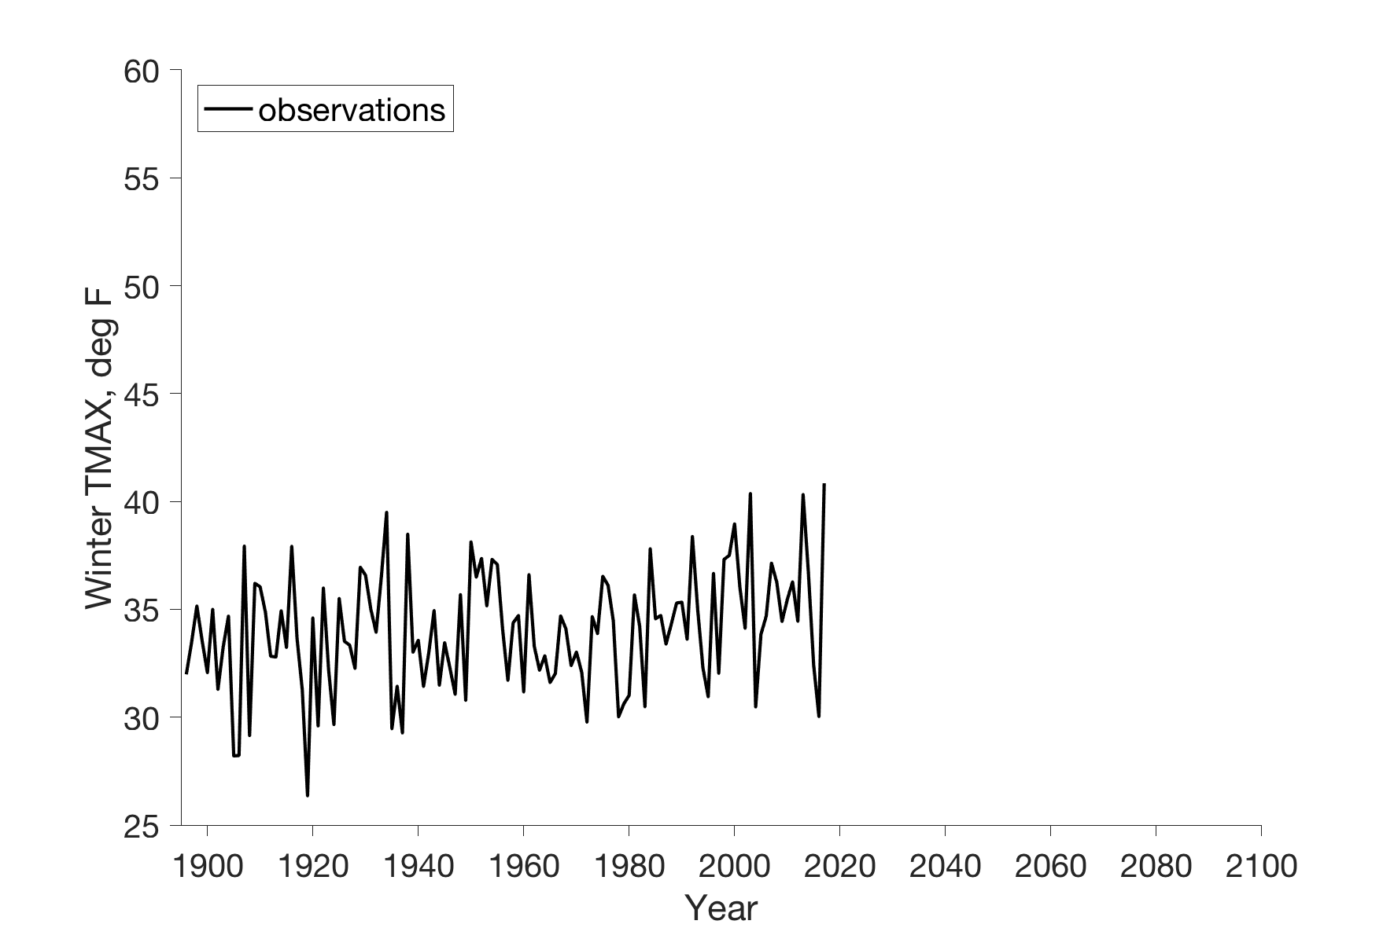
Warming trend of +2.2ºF, 1895-2016
Durham, NH
34ºF

Slide 18
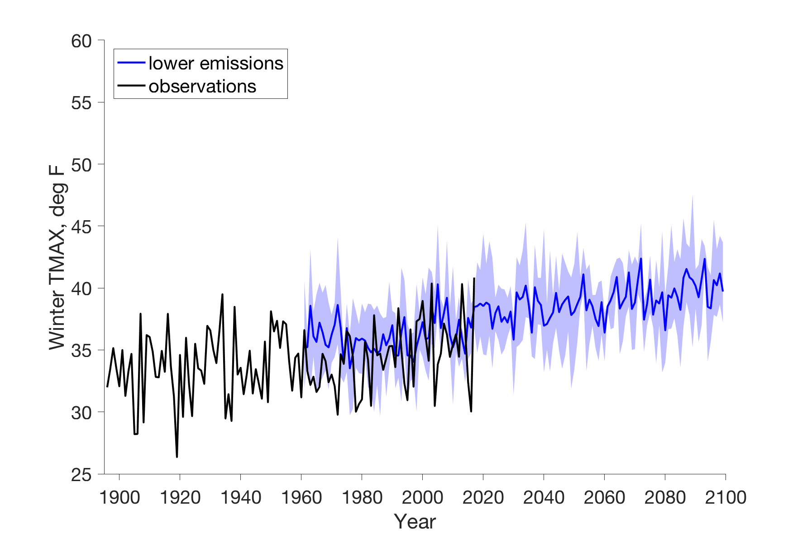
Winters of the late 1980s become rarer
39ºF
34ºF
Notes:
+5F above average. Winter 2012/2013.

Slide 19
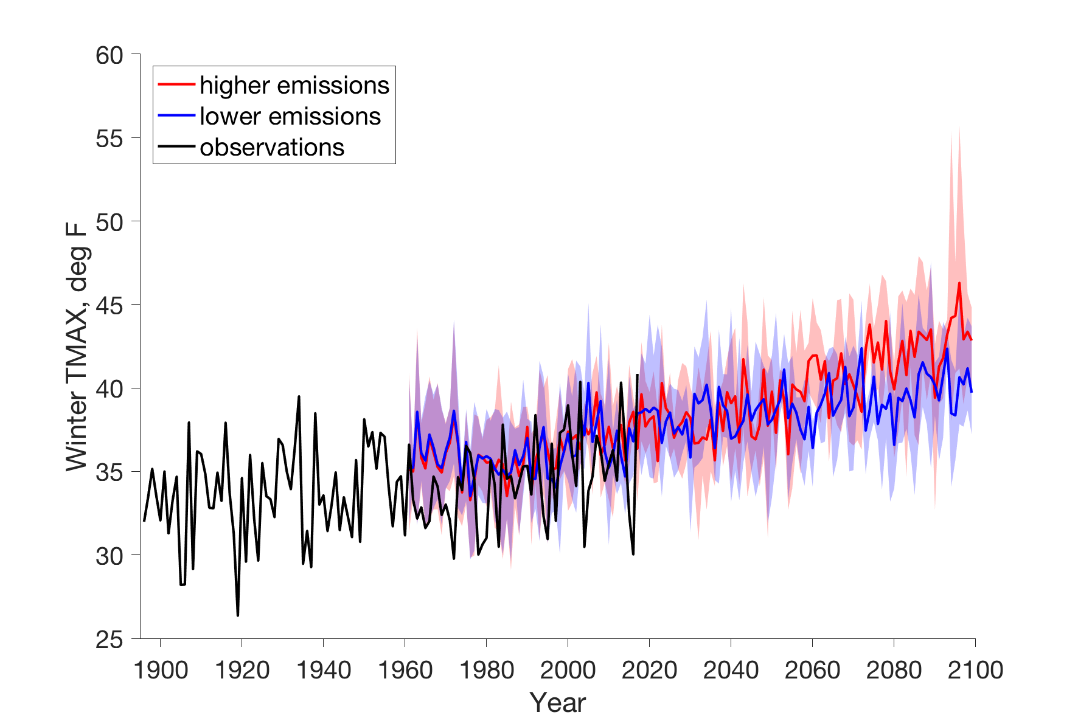
Winters of the late 1980s become rarer
43ºF
39ºF
34ºF
Notes:
+9 above average. Think winter 2015/2016. Skier visits were 30% below average that year. s

Slide 20
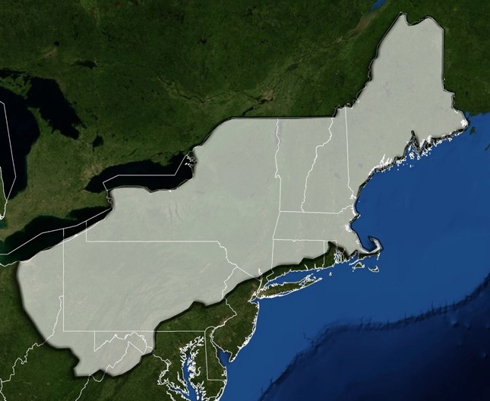
Historical area with > 30 days of continuous snow cover
Northeast Climate Impacts Assessment, 2007
Notes:
PA currently has more skier visits than NH.

Slide 21
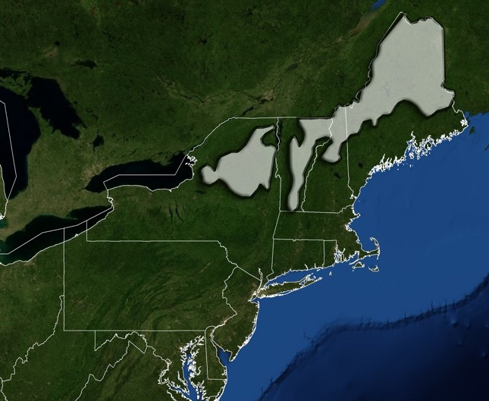
Projected area with > 30 days of continuous snow cover by 2100
Northeast Climate Impacts Assessment, 2007
Notes:
Under high emission (don’t take action)
Try to predict snowmaking operation costs under this scenario (w/out commensurate increase in efficiency)

Slide 22
What is the Vernal Window?
Notes:
Period between snowmelt and full canopy leaf-out
Exposure of soils and streams to light

Slide 23
Snowmelt to Canopy Closure
Contosta et al. 2017
My Mom, 1967
Notes:
Period between snowmelt and full canopy leaf-out
Exposure of soils and streams to light: time of ecological opportunity

Slide 24
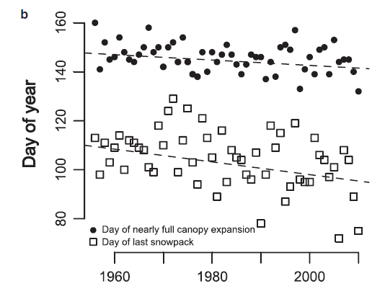
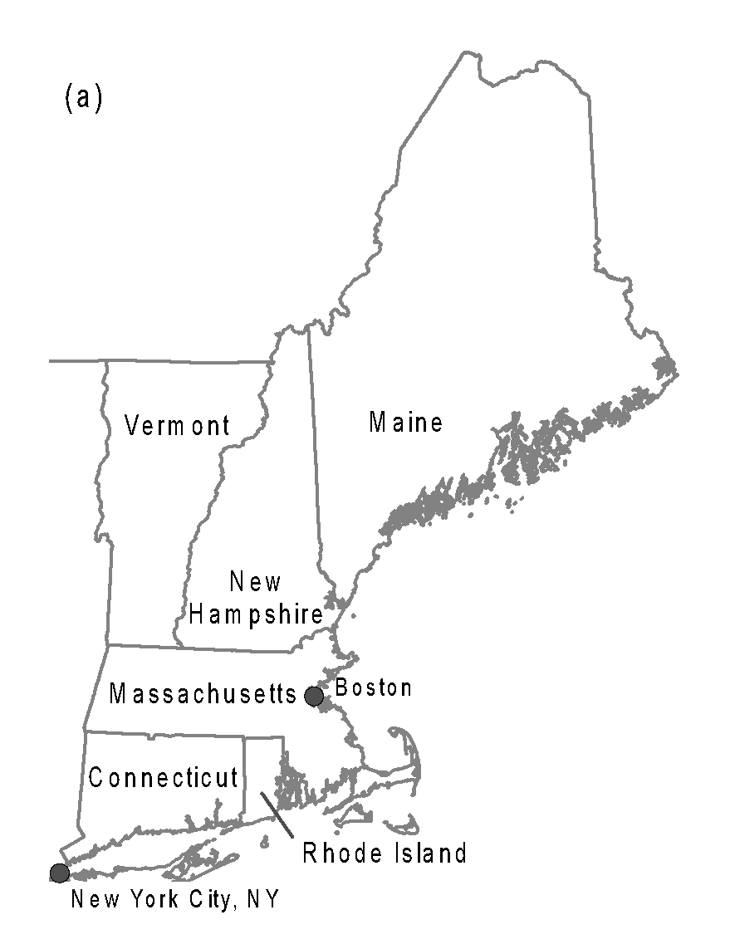
The date of snowpack disappearance occurs earlier in spring.
Hubbard
Brook
Groffman et al. 2012
Notes:
Looking at the y-axis (vertical axis):
What is day 90? March 31st
What is day 120? April 30th
When did snowpack disappear in the 1960s?
When did snowpack disappear in 2010?
The downward sloping line indicates earlier snowpack disappearance, a shorter snow season.

Slide 25
When did the snowpack disappear in 1960?
Hubbard
Brook
Groffman et al. 2012
Notes:
Looking at the y-axis (vertical axis):
What is day 90? March 31st
What is day 120? April 30th
When did snowpack disappear in the 1960s?
When did snowpack disappear in 2010?
The downward sloping line indicates earlier snowpack disappearance, a shorter snow season.

Slide 26
In 1960, snowpack disappeared around day 110, or March 20th.
Hubbard
Brook
Groffman et al. 2012
Notes:
Looking at the y-axis (vertical axis):
What is day 90? March 31st
What is day 120? April 30th
When did snowpack disappear in the 1960s?
When did snowpack disappear in 2010?
The downward sloping line indicates earlier snowpack disappearance, a shorter snow season.

Slide 27
When did the snowpack disappear in 2010?
Hubbard
Brook
Groffman et al. 2012
Notes:
When did snowpack disappear in 2010?

Slide 28
In 2010, snowpack disappeared around day 75, or March 16th
Hubbard
Brook
Groffman et al. 2012
Notes:
When did snowpack disappear in 2010?

Slide 29
The downward sloping line indicates an earlier snowpack disappearance.
Hubbard
Brook
Snow melts ~14 days earlier today than it did in the 1960s.
Groffman et al. 2012
Notes:
When did snowpack disappear in 2010?

Slide 30
Snowmelt to Canopy Closure
My Mom, 1967
Notes:
Period between snowmelt and full canopy leaf-out
Exposure of soils and streams to light: time of ecological opportunity

Slide 31
When did the canopy close in 1960?
Hubbard
Brook
Groffman et al. 2012
Notes:
Note the same y-axis (vertical axis). But now we are looking at the date of canopy closure.
When did the canopy close in the 1960s?

Slide 32
In 1960, the canopy closed around day 144, or May 23rd.
Hubbard
Brook
Groffman et al. 2012
Notes:
Note the same y-axis (vertical axis). But now we are looking at the date of canopy closure.
When did the canopy close in the 1960s?

Slide 33
In 2010, the canopy closed around day 135, or May 14th.
Hubbard
Brook
Groffman et al. 2012
Notes:
Note the same y-axis (vertical axis). But now we are looking at the date of canopy closure.
When did the canopy close in the 1960s?

Slide 34
In 2010, the canopy closed around day 135, or May 14th.
Hubbard
Brook
Canopy closes ~6 days earlier today than it did in the 1960s.
Groffman et al. 2012
Notes:
Note the same y-axis (vertical axis). But now we are looking at the date of canopy closure.
When did the canopy close in the 1960s?

Slide 35
Results in overall lengthening of the vernal window, by ~8 days.
Hubbard
Brook
Groffman et al. 2012
Notes:
That’s 8 more days of brown and mud ☹

Slide 36
Snowmelt to Canopy Closure
My Mom, 1967
Notes:
Period between snowmelt and full canopy leaf-out
Exposure of soils and streams to light: time of ecological opportunity

Slide 37
Tracking winter warming and the vernal window requires observations.
My Mom, 1967
Notes:
Period between snowmelt and full canopy leaf-out
Exposure of soils and streams to light: time of ecological opportunity

Slide 38
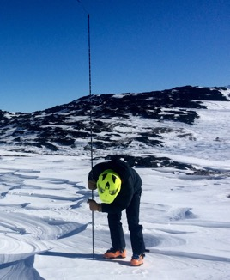
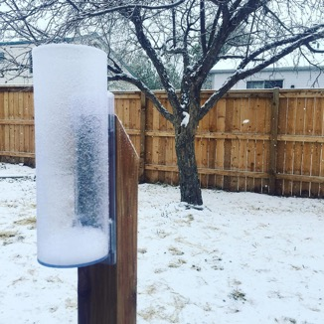



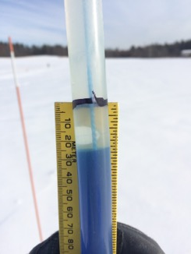

Three Ways Your Classroom Can
Contribute to Tracking Winter
Community
Snow Obs.
CoCoRaHS
GLOBE
Notes:
Ranked easiest and quickest on the left to more in-depth on the right.

Slide 39
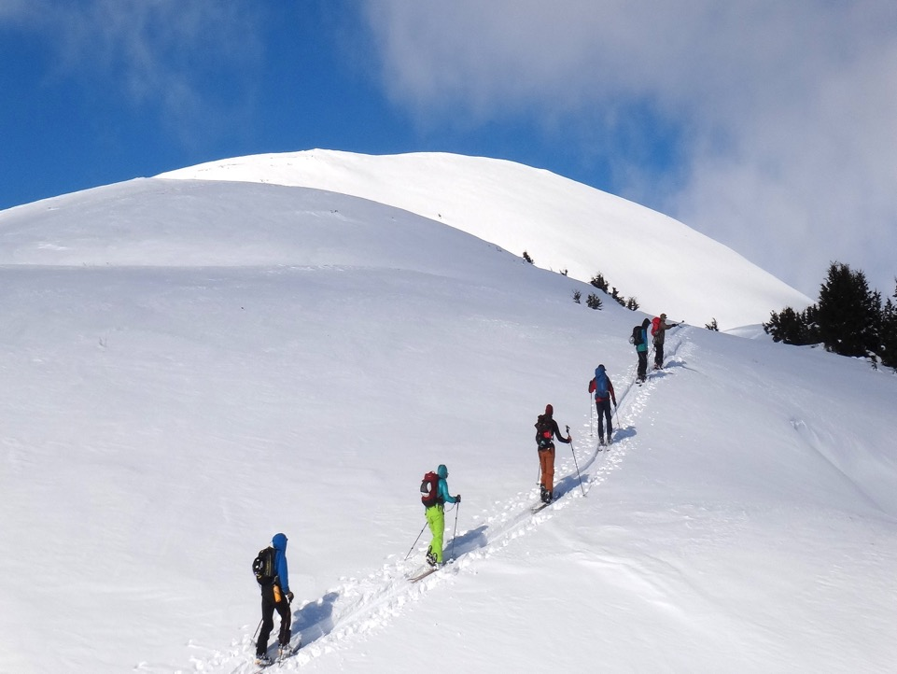


Fun for the whole family or classroom!
Community
Snow
Observations
CommunitySnowObs.org
Notes:
Now, we bring it around to the idea for CSO. A unique data opportunity.

Slide 40
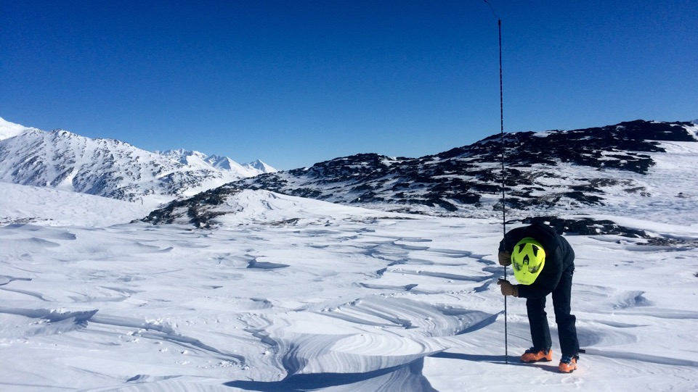
Community Snow Observations
CommunitySnowObs.org
Project Goal
Incorporate citizen scientist measurements into forecast models to better constrain snow forecasts.

Slide 41
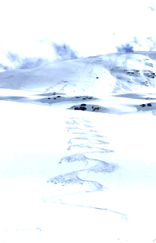
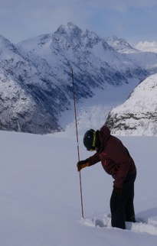


How it Works:
(1)
Install the MtnHub app
(2)
Take your Probe or Ruler outside
(3)
Take Your Phone
Notes:
How to participate in CSO in three steps…

Slide 42
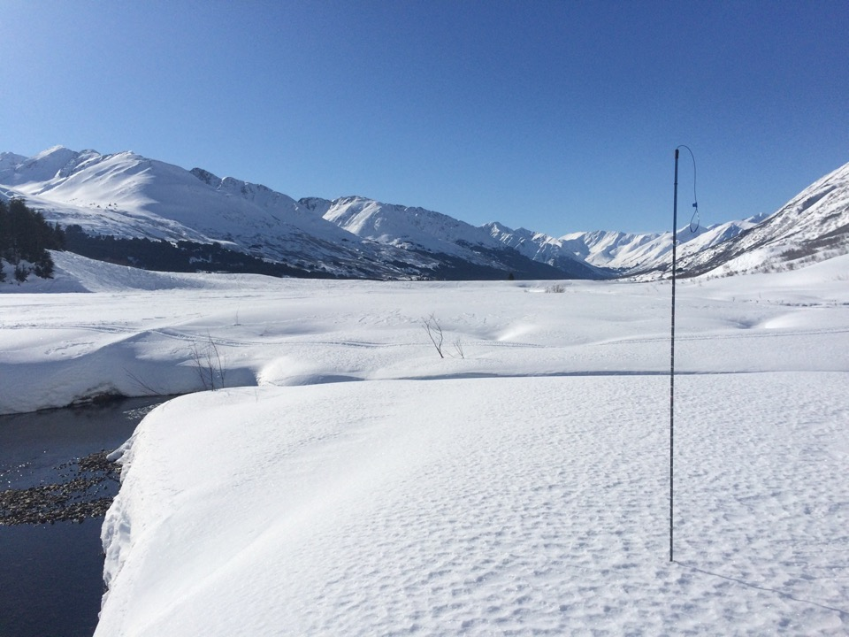

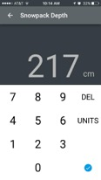
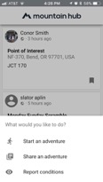
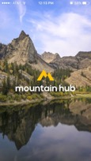
Collect three snow depth measurements and report the average on MtnHub.
210 cm
225 cm
+ 215 cm
= 650 cm /3
= 217 cm
215 cm
210 cm
Radius ~ 1m
225 cm
* Tutorials and best practices at CSO website.

Slide 43
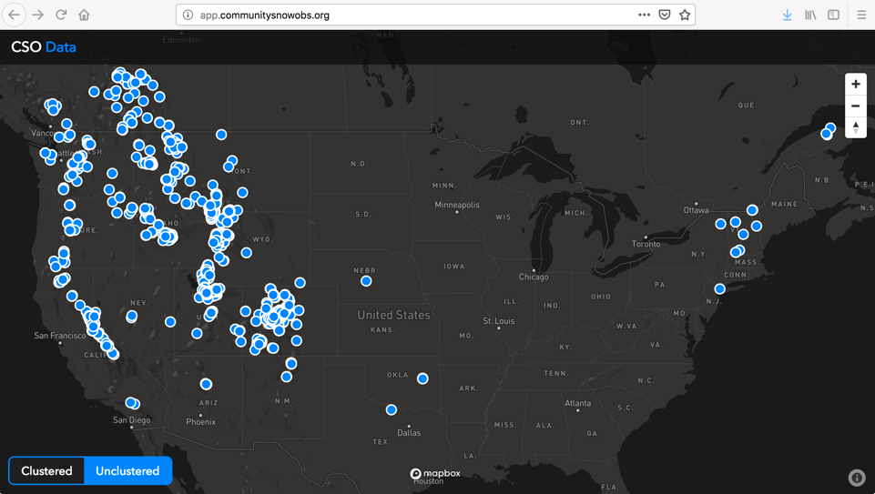
Where CSO data has been reported so far:
2016-present
Notes:
The western US is leading the charge. Let’s get some more in the Northeastern US! None from Maine at all yet!

Slide 44
Uses in the classroom and beyond:
Improves forecasts
Spatial comparison with other schools and locations
Long-term data collection at a single site to track weather, understand a time series

Slide 45

Three Ways Your Classroom Can
Contribute to Tracking Winter
Community
Snow Obs.
CoCoRaHS
GLOBE
Notes:
Ranked easiest and quickest on the left to more in-depth on the right.

Slide 46

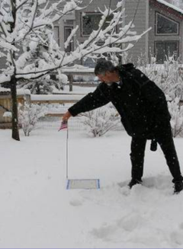
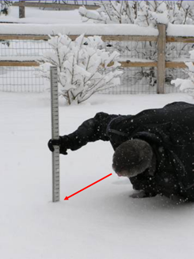
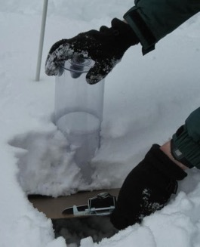
Community Collaborative Rain, Hail, and Snow Network
Total Snow Depth
Snow water
equivalent
New snow
Storm events
Notes:
Very detailed instructions on CoCoRaHS snow sampling here:
https://cocorahs.org/media/docs/measuringSnow2.1.pdf

Slide 47
Measuring new snow
Measure in the open, away from buildings and trees
A snow board (white plywood) is ideal because it is cleaned off after each storm.
Report to nearest 0.1 inches (ie: 5.3 inches)
Snow board
Notes:
Very detailed instructions on CoCoRaHS snow sampling here:
https://cocorahs.org/media/docs/measuringSnow2.1.pdf

Slide 48
Measuring total snow depth
Measure undisturbed snow in the open, away from buildings, trees, drifts, and plowed piles
Insert ruler vertically until it hits the ground surface.
Report to nearest 0.5 inches (ie: 5.5 inches)
Snow depth
Notes:
Very detailed instructions on CoCoRaHS snow sampling here:
https://cocorahs.org/media/docs/measuringSnow2.1.pdf

Slide 49
Measuring snow water equivalent
Snow water
equivalent
Measure undisturbed snow in the open, away from buildings, trees, drifts, and plowed piles
Insert gauge vertically until it hits the ground surface or snow board.
Melt and measure
Report to nearest 0.01 inches (ie: 2.06 inches)
Notes:
Melt and measure
Fill inner tube about 1/3 of way full with warm water (not boiling). Record amount in small tube.
Slowly add the known amount of warm water to the snow in the big tube and allow snow to melt
Once all of the snow has melted, pour all of the water into the small tube and record the new total amount.
Subtract the known amount of warm water from the total. The difference is the snow water equivalent!

Slide 50
Three Ways Your Classroom Can
Contribute to Tracking Winter
Community
Snow Obs.
CoCoRaHS
GLOBE
Notes:
Ranked easiest and quickest on the left to more in-depth on the right.

Slide 51
Vernal Window = Snowmelt to Canopy Closure
My Mom, 1967
Notes:
Recall from earlier that the vernal window is the period between snowmelt and full canopy leaf-out
Exposure of soils and streams to light: time of ecological opportunity

Slide 52
Results in overall lengthening of the vernal window, by ~8 days.
Hubbard
Brook
Groffman et al. 2012
Notes:
That’s 8 more days of brown and mud ☹

Slide 53

What is happening in our ecosystems during the vernal window?
ACTIVITY:
Organize the cards provided into a hypothesized sequence of events that occur in spring. Cards are color coded by their importance to ecosystem…
            energy (orange)
    carbon (green)
    water (blue)
Notes:
Put up a paper timeline. In small groups, place vernal window events on the timeline.
- snow melts
- soils and streams thaw
- rivers start to gush
- peepers!
- grasses and bulbs sprout
- buds burst
We don’t know if our exact sequence is correct, but it certainly is a hypothesis that can be tested with students!

Slide 54
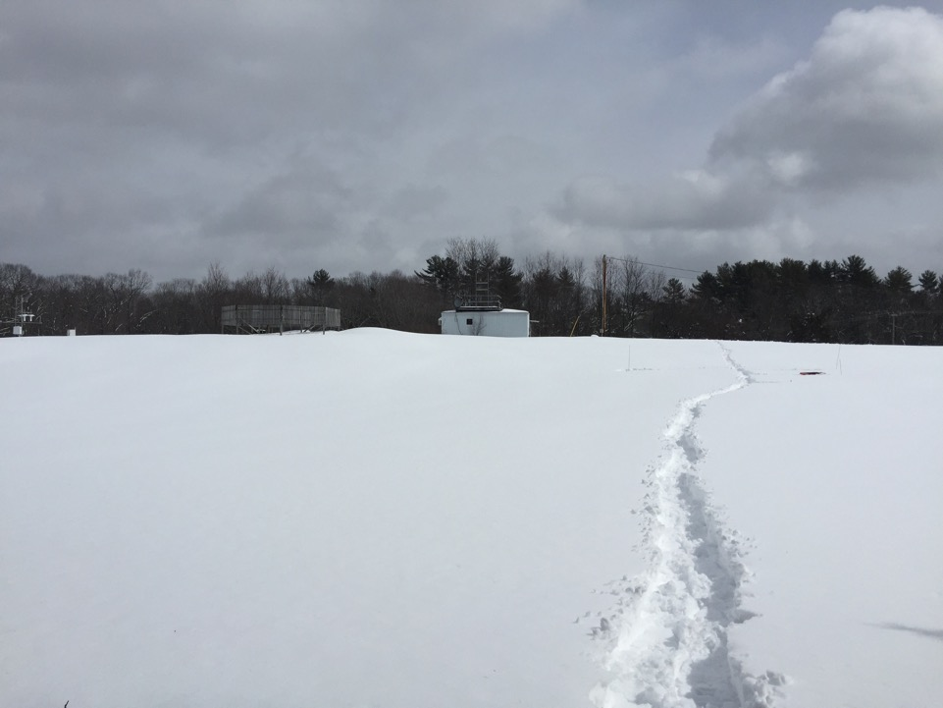
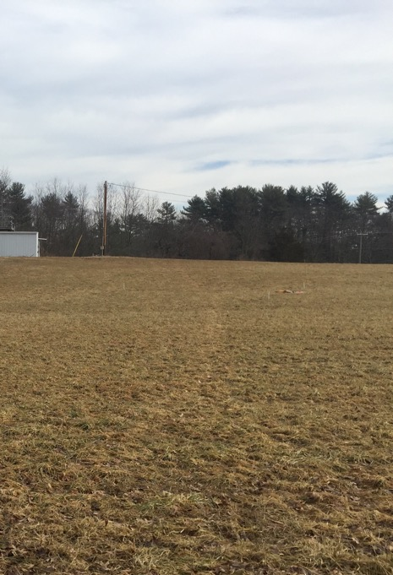
Snowmelt → Snow-free
Notes:
Snow-covered photo and snow-free photos of Thompson Farm from PicturePost.
When snow covered, the bright snow reflects a lot of the sun’s energy (high albedo)
When snow-free, the dark ground absorbs lots of the sun’s energy and warms up (low albedo).

Slide 55
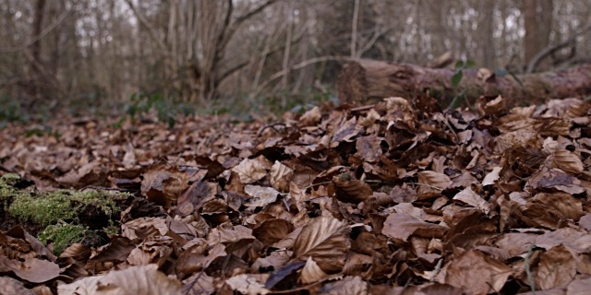
Snow-free → Budburst
During the snow-free period, soils warm up and microbes start respiring organic matter.
Respiration:
C₆H₁₂O₆ + O₂ → CO₂ + H₂O
Notes:
During the snow-free brown periods, respiration will release carbon dioxide from soils and organic matter (as long as soils are thawed)
A longer snow-free season means more CO2 to the atmosphere.

Slide 56
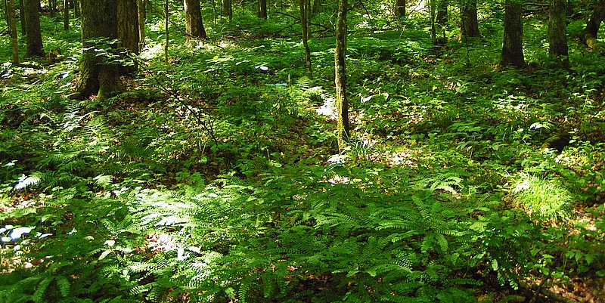
Snow-free → Budburst
Once budburst begins, ecosystem begins to take up carbon through photosynthesis.
Photosynthesis
CO₂ + H₂O → C₆H₁₂O₆ + O₂
Notes:
Once the canopies and understory start to leaf out, photosynthesis will start to draw down CO2 from the atmosphere.
While canopies are leafing out earlier, recall that it is not at the same rate as snow disappearance.
This means we have a longer period of time during the year when CO2 is being released to the atmosphere.

Slide 57

What will the vernal window look like in the future?
February 26, 2017 Kingman Farm, Durham, NH
Notes:
Photo taken two days after Boston broke their record for warmest temp ever in February. Not what we like to see in February.

Slide 58
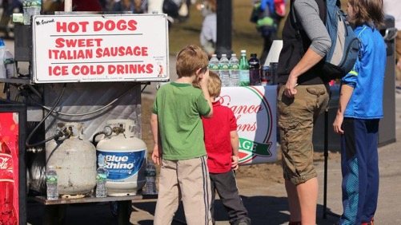
What will the vernal window look like in the future?
This is the warmest February day ever recorded in Boston _{Boston Globe}
February 26, 2017 Kingman Farm, Durham, NH
Notes:
Photo taken two days after Boston broke their record for warmest temp ever in February. Not what we like to see in February.

Slide 59
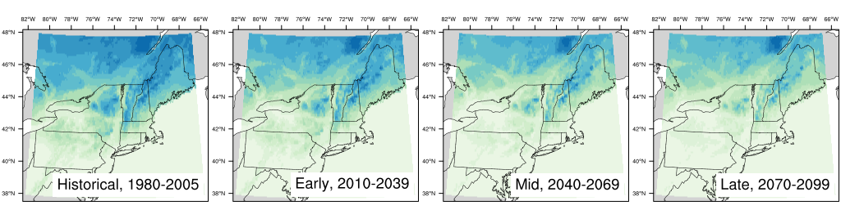

Less snow in a warmer world
Lower emissions (RCP4.5)
Burakowski et al. in prep
Notes:
~6” assuming 200 kg/m3 (30/0.2 = 150 mm = 5.9”)

Slide 60
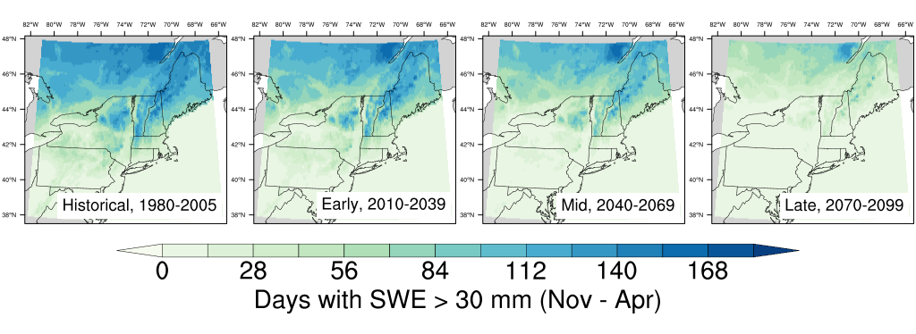
Elimination of vernal window?
Lower emissions (RCP4.5)
Higher emissions (RCP8.5)
Notes:
And possible elimination of vernal window altogether in southern part of domain.

Slide 61


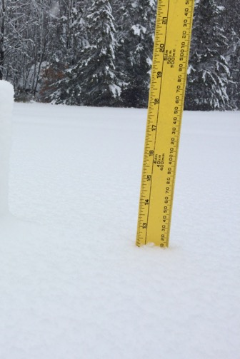
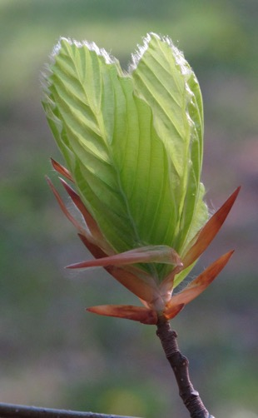

www.globe.gov
Tracking the vernal window using
bundled GLOBE protocols
Canopy Green-Up
Soil frost
depth
Snow depth
Photo: Alden Adolph

Slide 62
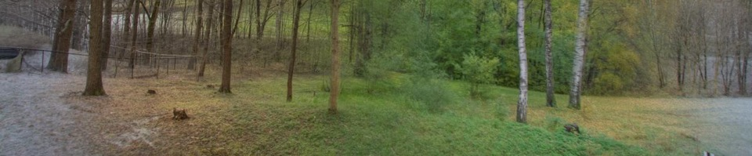
Research Objectives
Determine sequence of transitions during vernal window
Understand how climate change might alter these transitions and the lags that occur between them

Slide 63
www.globe.gov
Soil Frost Depth
Materials:
PVC pipe, clear tubing, rubber stoppers, methleyne blue, string*
Data sheet or field notebook
Pencil
*detailed instructions on globe.gov
Soil frost
depth
Protocol:
Approach tube and minimize disturbance of snow pack
Pull rubber stopper and inner tube out of PVC casing
Measure soil frost depth (clear) from black line downward to blue liquid.
Place tube back in PVC pipe
Photo: Alden Adolph

Slide 64
www.globe.gov
Snow Depth
Materials:
Meter stick (measure in cm)
Data sheet or field notebook
Pencil
Protocol:
Insert meter stick vertically into snowpack, about a foot away from soil frost tube
Report snow depth to nearest 0.1 cm
Repeat for all frost tubes
Photo: Alden Adolph

Slide 65

www.globe.gov
Canopy Green-Up
Materials:
Ribbon
Permanent marker
Data sheet
Protocol:
Select a tree and identify the species. Tie ribbon around branch
Mark buds on branch with 1-4 dots.
Examine buds and record observations:
  Dormant, swelling, budburst, or lost.
  If budburst, measure lengh of leaf from base to tip until fully grown.

Slide 66
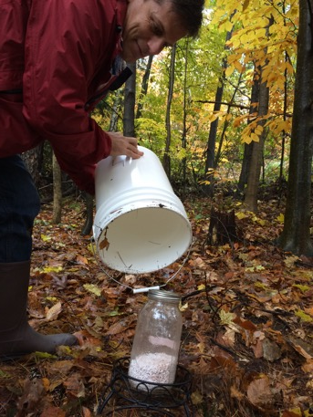
www.globe.gov
Soda Lime Base Trap
Materials:
5 gallon bucket
Glass mason jar
Small plant stand
Trowel or serrated knife
Graduated cylinder
Drying oven
Scale
400 grams of soda lime
600 ml Deionized water
Protocol:
Fully dry and weigh soda lime sample, seal tightly in mason jar.
At the field site, invert bucket on soil, use serrated knife to cut around perimeter of bucket into the soil.
Remove bucket and place plant stand in the center of the soil circle you just cut

Slide 67
www.globe.gov
Soda Lime Base Trap
Protocol:
Open jar (avoid breathing in jar!) and add 50 ml of deionized water. Secure lid and gently shake to moisten soda lime.
If this is your control jar, keep the mason jar lid on and invert the bucket over the jar and plant stand.
Remove mason jar lid (again, avoid breathing your CO₂ rich breath on the sample) and place mason jar on plant stand. Invert bucket over sample and place a large rock or piece of wood on top of the bucket to keep it sealed over the winter.

Slide 68
www.globe.gov
Soda Lime Base Trap
Protocol:
After the canopy leafs out, remove the bucket and seal the jar.
Dry the sample in a drying oven and re-weigh.
Respiring soils will ’gain weight’ over the winter.
From the sample weight gain, we calculate CO₂ flux.
2NaOH (s) + CO2 (g) ↔ Na2CO3 (s) + H2O (ads) [1]
Ca(OH)2 (s) + CO2 (g) ↔ CaCO3 (s) + H2O (ads) [2]

Slide 69
Three Ways Your Classroom Can
Contribute to Tracking Winter
Community
Snow Obs.
CoCoRaHS
GLOBE
Notes:
Ranked easiest and quickest on the left to more in-depth on the right.

Slide 70

Thanks and Questions

